Slide 1
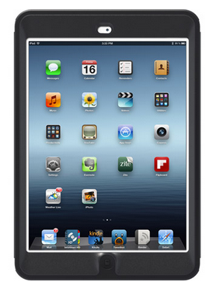
Front
iPad Driver’s License
iPad Driver’s License
iPad Driver’s License
Name:
iPad #
Name:
iPad #
Name:
iPad #
iPad Driver’s License
iPad Driver’s License
iPad Driver’s License
Name:
iPad #
Name:
iPad #
Name:
iPad #

Slide 2
Back
iPad Expectations
iPad Expectations
iPad Expectations
1. Hold the iPad with two hands.
2. Place the iPad down carefully on the desk.
3. Never leave the iPad on the floor.
4. Keep food and drinks away from the iPad.
5. Turn off the iPad screen when the
teacher talks.
6. Use only apps you’ve been told to use.
7. Do not add or delete apps.
8. Keep personal information private – only use first name.
1. Hold the iPad with two hands.
2. Place the iPad down carefully on the desk.
3. Never leave the iPad on the floor.
4. Keep food and drinks away from the iPad.
5. Turn off the iPad screen when the
teacher talks.
6. Use only apps you’ve been told to use.
7. Do not add or delete apps.
8. Keep personal information private – only use first name.
1. Hold the iPad with two hands.
2. Place the iPad down carefully on the desk.
3. Never leave the iPad on the floor.
4. Keep food and drinks away from the iPad.
5. Turn off the iPad screen when the
teacher talks.
6. Use only apps you’ve been told to use.
7. Do not add or delete apps.
8. Keep personal information private – only use first name.
iPad Expectations
iPad Expectations
iPad Expectations
1. Hold the iPad with two hands.
2. Place the iPad down carefully on the desk.
3. Never leave the iPad on the floor.
4. Keep food and drinks away from the iPad.
5. Turn off the iPad screen when the
teacher talks.
6. Use only apps you’ve been told to use.
7. Do not add or delete apps.
8. Keep personal information private – only use first name.
1. Hold the iPad with two hands.
2. Place the iPad down carefully on the desk.
3. Never leave the iPad on the floor.
4. Keep food and drinks away from the iPad.
5. Turn off the iPad screen when the
teacher talks.
6. Use only apps you’ve been told to use.
7. Do not add or delete apps.
8. Keep personal information private – only use first name.
1. Hold the iPad with two hands.
2. Place the iPad down carefully on the desk.
3. Never leave the iPad on the floor.
4. Keep food and drinks away from the iPad.
5. Turn off the iPad screen when the
teacher talks.
6. Use only apps you’ve been told to use.
7. Do not add or delete apps.
8. Keep personal information private – only use first name.

